Slide 1
Crime In India
By: Daniel Phelps, Nicholas Ricci, Tyler Willis

Slide 2
Topic Selection
Basic Data Mining Visualizations
Fundamental data visualizations, including bar graphs, line graphs, scatter plots, histograms, correlation matrices, and box plots.
Dimensionality Reduction
Techniques such as PCA, LDA, and t-SNE to simplify data while retaining core patterns.
Clustering Algorithms
Analyzing clusters using iterative clustering, hierarchical clustering, density-based clustering, and probability-based clustering to uncover regional crime patterns and associations.

Slide 3
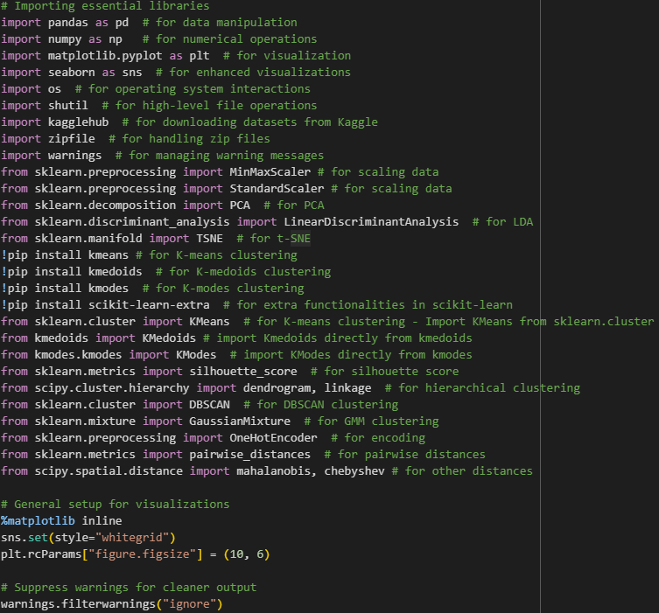
Importing Necessary Libraries
The following code imports essential libraries for data manipulation, visualization, scaling, dimensionality reduction, and clustering algorithms.
The following code configures matplotlib for inline plotting with Seaborn for enhanced and consistent visualizations.
The following code suppresses warnings to maintain a cleaner output for easier code readability and analysis.

Slide 4
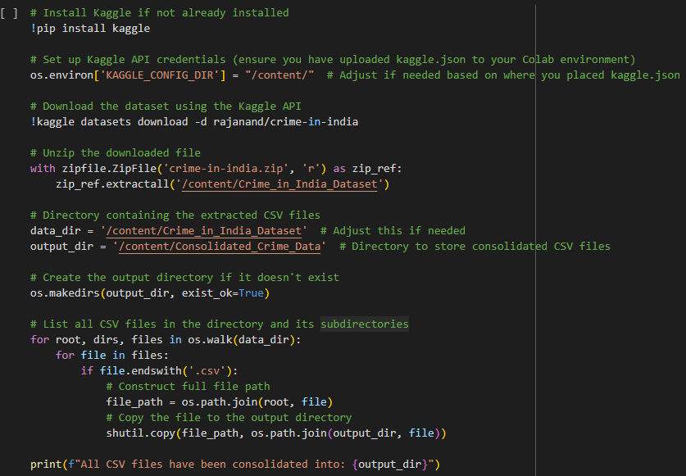
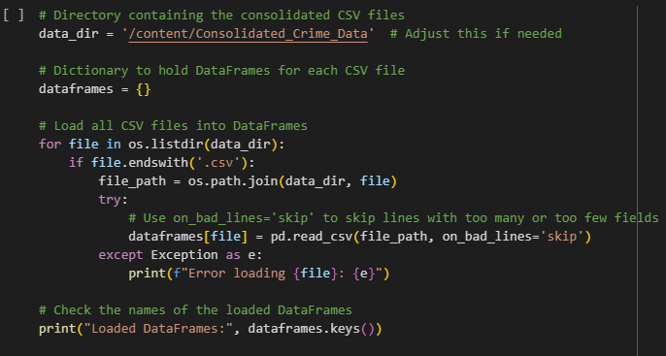
Extracting the Zip File and Loading the Data

Slide 5
Extracting the Zip File and Loading the Data
Kaggle Installation and Dataset Download
The following code in the first picture installs Kaggle, sets up API credentials, and downloads the Crime in India dataset directly to Colab.
File Extraction and Consolidation
The following code in the first picture extracts the dataset and consolidates all CSV files into a central directory for organized access.
Data Loading into DataFrames
The following code in the second picture loads each CSV file into separate DataFrames, handling any misaligned fields, and prints the names of loaded DataFrames to confirm successful import.

Slide 6
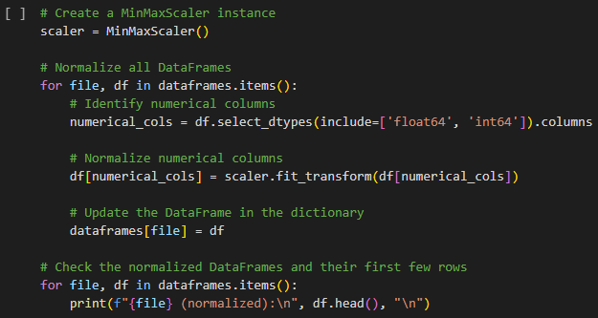
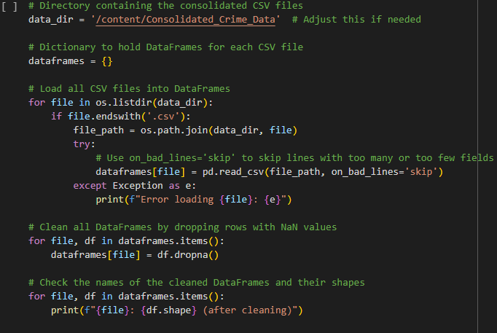
Cleaning and Normalizing the Data

Slide 7
Cleaning and Normalizing the Data
Data Loading and Cleaning
The following code in the first picture loads all CSV files into DataFrames, drops rows with NaN values, and prints the names and shapes of the cleaned DataFrames to confirm successful cleaning.
Normalization of DataFrames
The following code in the second picture creates a MinMaxScaler instance to normalize numerical columns in each DataFrame, updating them accordingly and displaying the first few rows of the normalized DataFrames for verification.

Slide 8
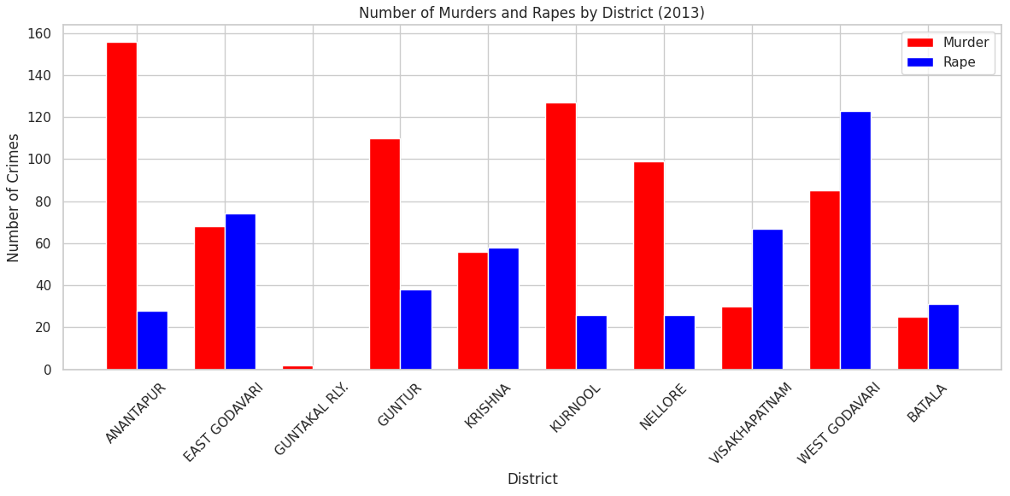
Bar Graph Analysis
The number of murders and rapes in 2013 were the lowest for the district of Guntakal Railway.
The number of murders in 2013 were the highest for the district of Amantapur.
The number of rapes in 2013 were the highest for the district of West Godavari.
From the bar graph, it appears that it’s possible there are almost no murders and rapes in Guntakal Railway because of its status of being a railway.

Slide 9
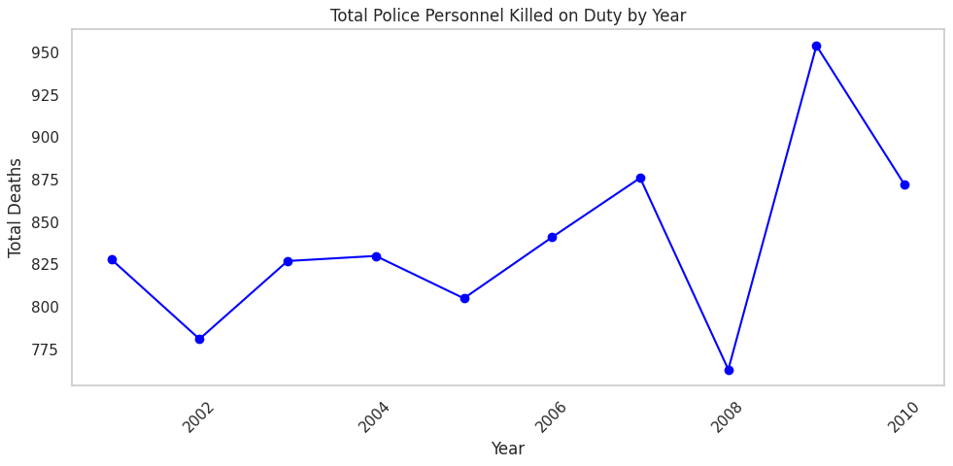
Line Graph Analysis
The line graph shows a moderately positive trend of police personnel killings from year 2000 to year 2007.
Following the massive dip of police personnel killed in 2008, a massive spike of police personnel were killed in 2009.
The trend of police personnel killings becomes unstable and hard to tell with the short amount of years given after 2008.

Slide 10
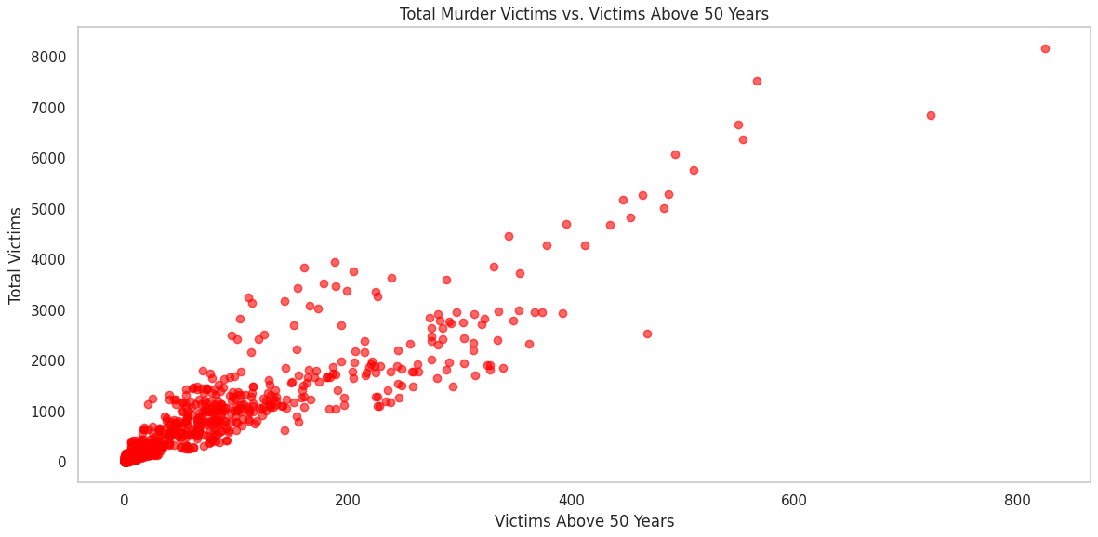
Scatter Plot Analysis
There seems to be a strong positive trend with the scatterplot depicting total murder victims and victims above 50 years.
Most of the data in the scatterplot is clustered/partitioned around 4000 total victims and 400 victims above 50 years.
The outliers on the upper right area of the graph imply that there is a deeper meaning for these mass killings of an older audience and should be investigated deeper.

Slide 11
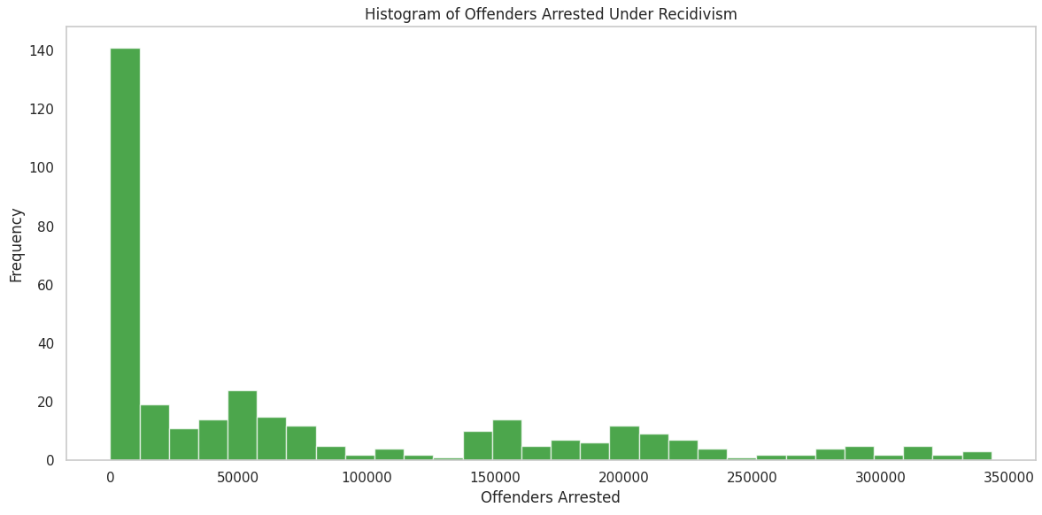
Histogram Analysis
It appears that there is a high frequency of a very low amount of offenders arrested under recidivism as denoted by the large bin from approximately 0 to roughly 10000 offenders arrested under recidivism
The histogram has a large range and contains many centers as seen by the patterns in the spread. For instance, there is a center around 50000, 20000, and even 300000 offenders arrested.
Due to the large frequency in the lack of offenders arrested, this histogram is skewed right.

Slide 12
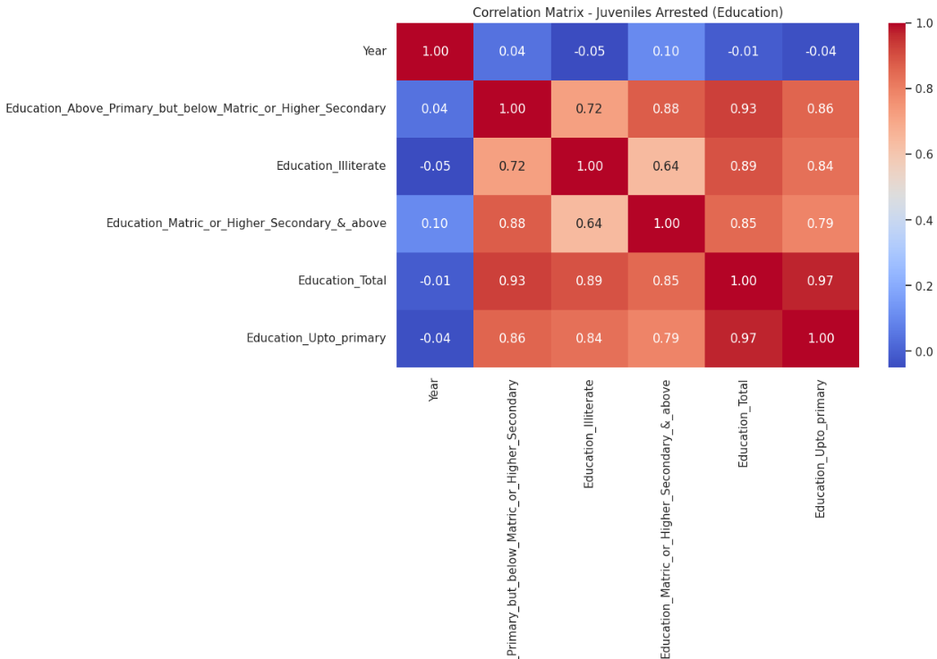
Correlation Matrix Analysis
In terms of Juveniles Arrested (Education), the most correlated events seem to be between Education_Total and education_Upto_primary.
Meanwhile, the least correlated events seem to be between Education_Total and Year.
Furthermore, a juvenile in educations that are in secondary and/or higher also experience large correlations to being arrested especially if they are illiterate.

Slide 13
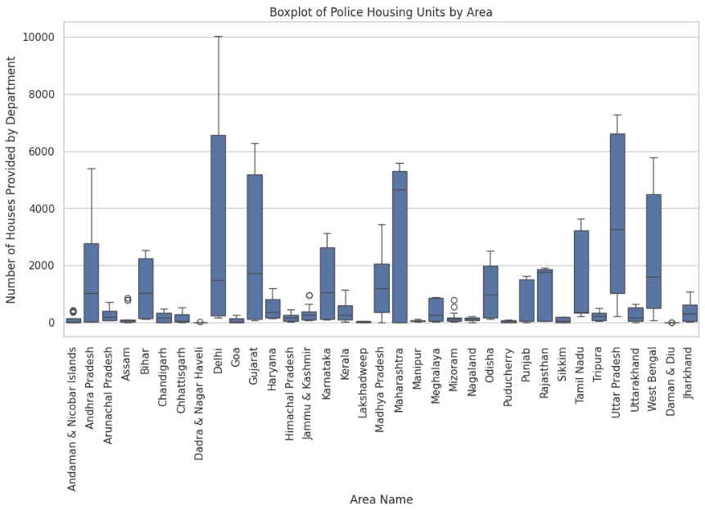
Boxplot Analysis
Delhi had the largest IQR in the boxplots of police housing by units, furthermore, the IQRs of this csv were much larger compared to the other csv’s chosen.
Delhi had a much higher maximum value at around 10000 to be precise than all the other boxplots.
There appear to be considerably more outliers in boxplots that have very tiny IQRs than large IQR boxplots. For instance, places like Mizoram, Assam, and the Andaman & Nicobar Islands seem to have a very small number of houses provided by the department and have more outliers than the places with a larger amount of houses provided.

Slide 14
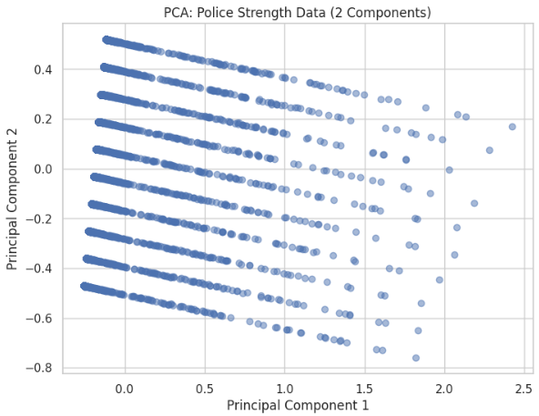
Applying PCA, LDA, and t-SNE
  Data is projected onto two principal components.
  Linear separation exists in this projection, but the data points are highly compressed in a sloping pattern.
  The data shows variance but lacks clear clustering, indicating that the primary goal is dimensional reduction rather than classification.
  PCA simplifies the data, but no distinct class separations or clusters are evident in this projection.

Slide 15
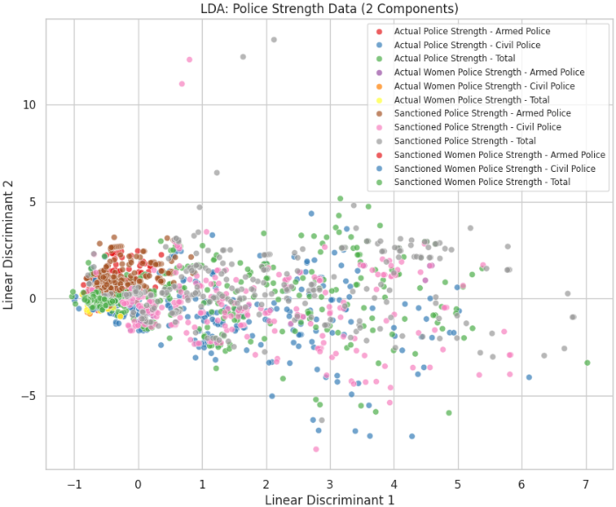
Applying PCA, LDA, and t-SNE
Clear clustering patterns can be observed across the two linear discriminants.
Different categories (actual vs. sanctioned police strength) are well-separated into distinct groups.
LDA maximizes class separability, indicating it is effective for classification tasks within this data.
LDA shows that the police strength categories can be clearly differentiated, making it suitable for supervised classification.

Slide 16
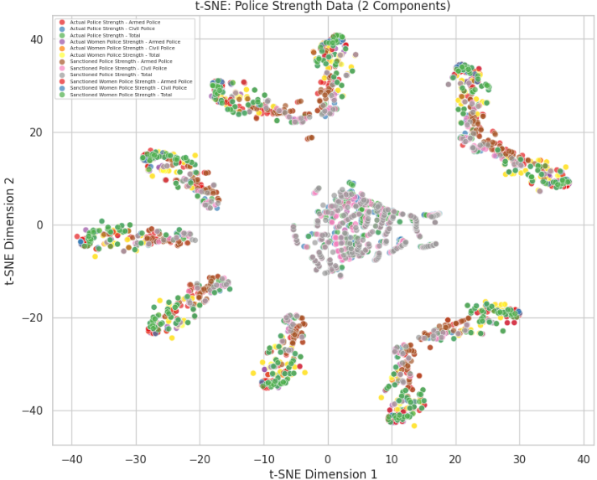
Applying PCA, LDA, and t-SNE
Distinct clusters of data points are evident, with some data groups overlapping in the center.
More effective at capturing non-linear relationships between different data categories compared to PCA and LDA.
Each cluster represents similar categories, showing that t-SNE uncovers complex groupings.
t-SNE provides a more detailed clustering and visualization of the data, ideal for exploring complex, non-linear patterns.

Slide 17
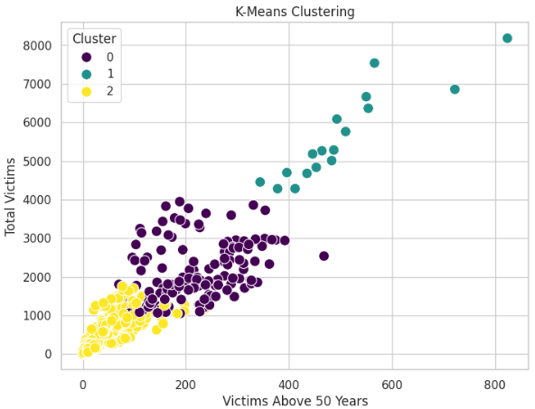
Iterative Clustering Analysis
K-Means is an iterative clustering algorithm that partitions data into k-distinct clusters based on feature similarity. The algorithm iteratively assigns data points to the nearest cluster center and updates the cluster centers until convergence.
K-means clustering seems to do a good job in taking the data shown from earlier from the scatterplot and breaking it up into three reasonable clusters.

Slide 18
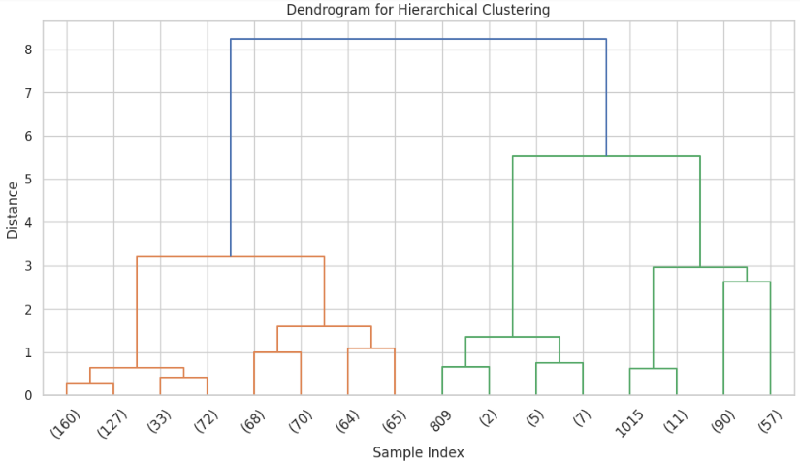
Hierarchical Clustering Analysis
The dendrogram provides a visual representation of the relationships between data points.
In order to focus on broader groupings, our team took the original dendrogram and truncated it.
The dendrogram illustrates how closely related different samples are, which can provide insights into the characteristics of murder victims across various age groups.

Slide 19
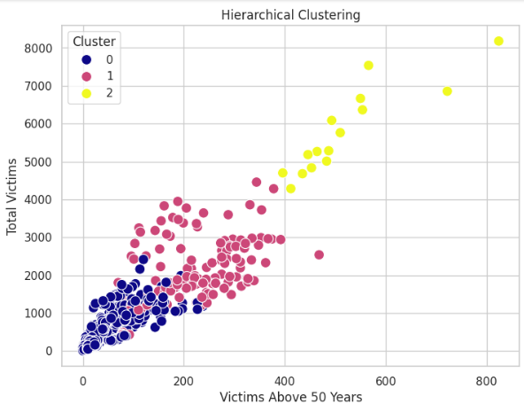
Hierarchical Clustering Analysis
The data appears to be clustered in a similar manner as the K-means clustering and does a good job with partitioning.
There appear to be very few points that are differently clustered than the K-means approach.
This implies that both iterative clustering and hierarchical clustering are good approaches to this data.

Slide 20
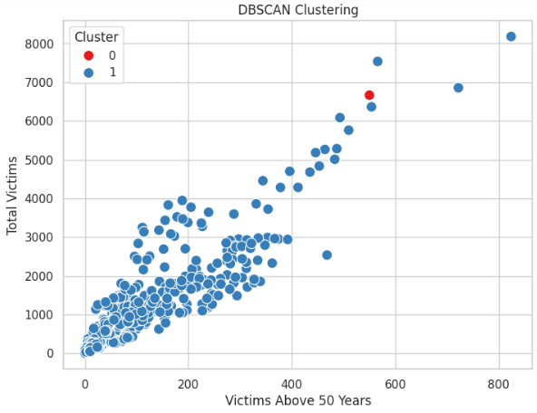
Density Based Clustering Analysis
DBSCAN identifies clusters based on the density of data points in the feature space. It groups closely packed points while marking sparse regions as noise.
It appears that this approach wasn’t particularly as useful in clustering as the K-means or Hierarchical methods.
The one point in red may have some significance in terms of this approach, but it seems like DBSCAN is not the best here.

Slide 21
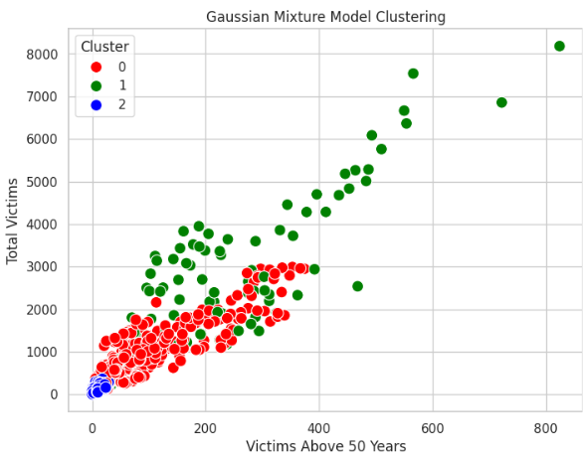
Probability Based Clustering Analysis
GMM is a probabilistic model that assumes data points are generated from a mixture of several Gaussian distributions. It provides a soft clustering approach where each data point has a probability of belonging to each cluster.
Based on this approach of clustering, it appears that a good attempt was made to cluster the data based on probability as it does include three clusters and the clusters are almost similar to the ones generated in K-means and Hierarchical clustering.

Slide 22
Conclusion
Data Visualizations
Various visualization techniques, including bar graphs, line graphs, scatter plots, histograms, correlation matrices, and boxplots, effectively illustrated crime trends and relationships within the dataset, facilitating a clearer understanding of the data.
Dimensionality Reduction
Techniques like PCA, LDA, and t-SNE were instrumental in simplifying complex datasets, highlighting significant variables while preserving essential information for further analysis.
Clustering Approaches
Implementing iterative, hierarchical, density-based, and probability-based clustering methods revealed distinct patterns and groupings within the data, offering insights into crime demographics and behaviors.
Key Insights
The combination of visualizations and advanced analysis techniques enhanced our understanding of crime data, identifying critical trends and anomalies that can inform decision-making.
Future Directions
Continued exploration of advanced techniques and integration of additional datasets can further deepen insights and support effective crime prevention strategies.

Slide 23
Works Cited
https://machinelearningmastery.com/dimensionality-reduction-algorithms-with-python/
https://hex.tech/blog/comparing-density-based-methods/
https://www.analyticsvidhya.com/blog/2019/10/gaussian-mixture-models-clustering/
https://www.javatpoint.com/packages-of-data-visualization-in-python

